Slide 1
OVERLOADING AND OVERRIDING

Slide 2
I
Overloading
Overloading is a simple technique, to enable a single function name to accept parameters of different type. Let us see a simple Adder class. Import the System namespace (already available in .NET).
Imports System
Class Adder
Here, we have two Add() functions. This one adds two integers. Convert.ToString is equivalent to the good old CStr.

Slide 3
Overloads Public Sub Add(A as Integer, B as Integer)
Console.Writeline ("Adding Integers: " + Convert.ToString(a + b)) End Sub

Slide 4
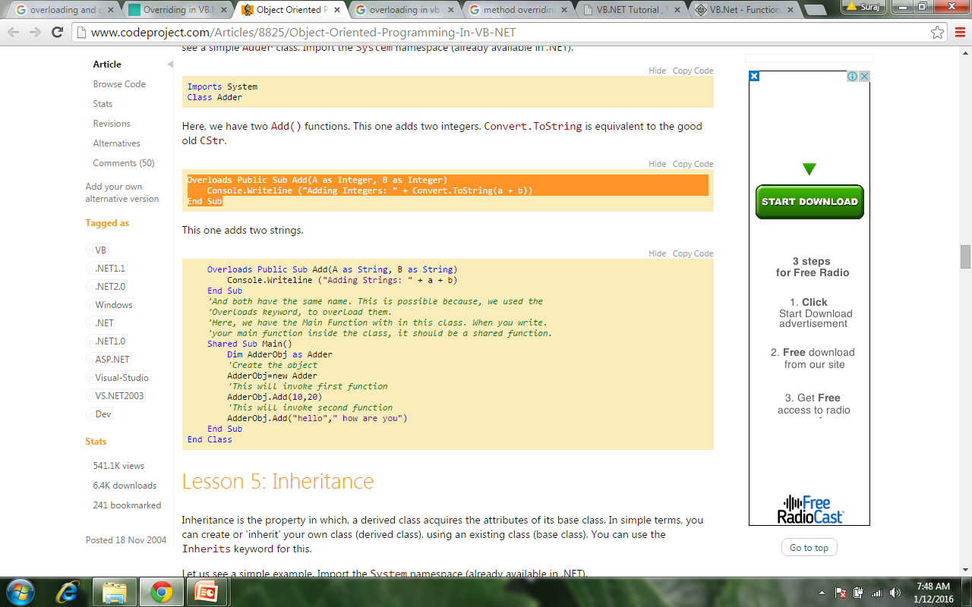

Slide 5
Inheritance
Inheritance is the property in which, a derived class acquires the attributes of its base class. In simple terms, you can create or 'inherit' your own class (derived class), using an existing class (base class). You can use theInherits keyword for this.
Let us see a simple example. Import the System namespace (already available in .NET).
Imports System

Slide 6
Our simple base class:
Class Human
'This is something that all humans do
Public Sub Walk()
Console.Writeline ("Walking")
End Sub
End Class

Slide 7
Now, let us derive a class from Human.
A Programmer is a Human.
Class Programmer
  Inherits Human
'We already have the above Walk() function 'This is something that all programmers do ;) Public Sub StealCode()
Console.Writeline ("Stealing code")
End Sub
End Class
Just a MainClass.

Slide 8
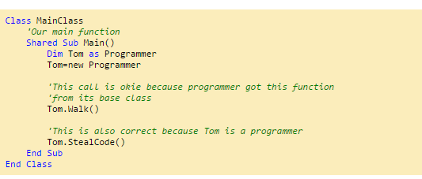

Slide 9
MustInheritThe MustInherit keyword specifies that a class cannot be instantiated and can be used only as a base class. I.e., if you declare our Human class as "MustInherit Class Human", then you can't create objects of type Human without inheriting it.
NotInheritableThe NotInheritable keyword specifies that a class cannot be inherited. I.e., if you specify 'NotInheritable Class Human', no derived classes can be made from the Human class.

Slide 10
Overriding
By default, a derived class Inherits methods from its base class. If an inherited property or method needs to behave differently in the derived class it can be overridden; that is, you can define a new implementation of the method in the derived class. The Overridable keyword is used to mark a function as overridable. The keywordOverrides is used to mark that a function is overriding some base class function. Let us see an example.
Import the System namespace (already available in .NET).
Imports System

Slide 11
Our simple base class:
Class Human
'Speak() is declared Overridable
Overridable Public Sub Speak() Console.Writeline ("Speaking")
End Sub
End Class

Slide 12
Now, let us derive a class from Human:
An Indian is a Human:

Slide 13
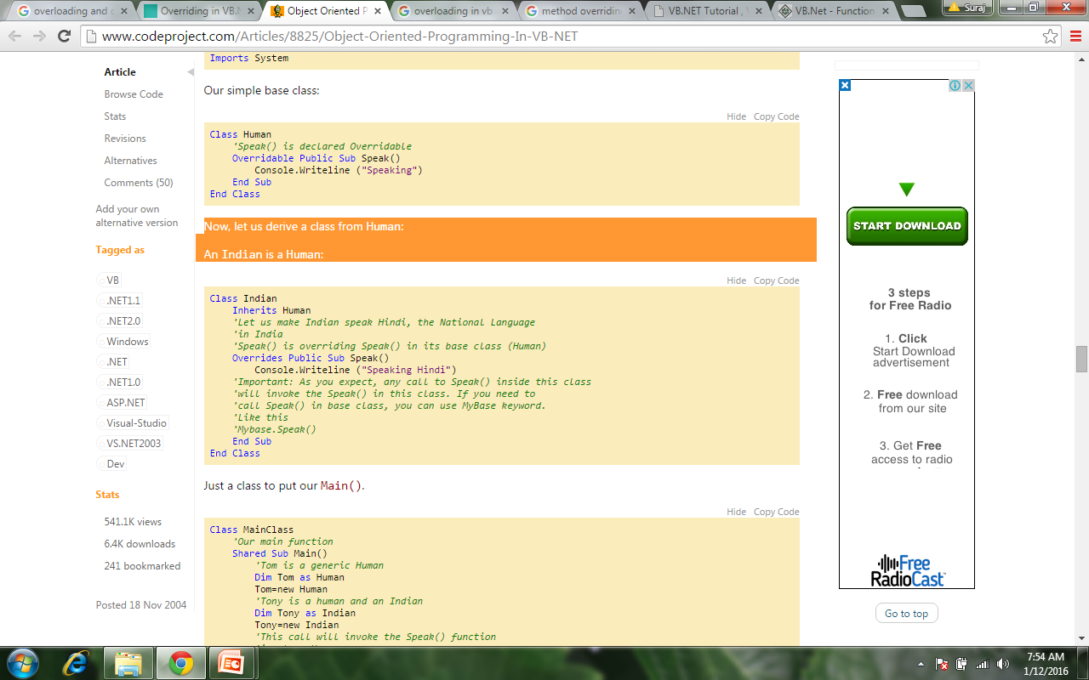

Slide 14
Just a class to put our Main().

Slide 15
